Slide 1
Machine Listening and Music Production: A Discrimination-Generation Feedback Loop Using Amper Music and Icelandic Indie Audio Data
Alex Sigman
Amper Music
NYCDSA Capstone Project

Slide 2
Outline
Amper Music
Project Motivations and Methodologies
EDA: Amper Training Data
Feature Extraction
Modeling
Model Integration
Single and Multi-Region Render Generation
Validation
Conclusions/Future Work

Slide 3

Amper Music?

Slide 4
Amper Music?
AI-driven music tech startup based in NYC and LA

Slide 5
Amper Music?
AI-driven music tech startup based in NYC and LA
Generates flexible stock music for content creators (filmmakers, podcast producers, game designers, etc.)

Slide 6
Amper Music?
AI-driven music tech startup based in NYC and LA
Generates flexible stock music for content creators (filmmakers, podcast producers, game designers, etc.)
All samples recorded and produced in LA

Slide 7
Amper Music?
AI-driven music tech startup based in NYC and LA
Generates flexible stock music for content creators (filmmakers, podcast producers, game designers, etc.)
All samples recorded and produced in LA
Music data created in-house by Asset Creation team

Slide 8
Amper Music?
AI-driven music tech startup based in NYC and LA
Generates flexible stock music for content creators (filmmakers, podcast producers, game designers, etc.)
All samples recorded and produced in LA
Music data created in-house by Asset Creation team
Musical output generated via algorithm and audio rendering engines

Slide 9
Amper Music?
AI-driven music tech startup based in NYC and LA
Generates flexible stock music for content creators (filmmakers, podcast producers, game designers, etc.)
All samples recorded and produced in LA
Music data created in-house by Asset Creation team
Musical output generated via algorithm and audio rendering engines
Users engage with Amper via Score web-based app or API

Slide 10
Amper Music?
AI-driven music tech startup based in NYC and LA
Generates flexible stock music for content creators (filmmakers, podcast producers, game designers, etc.)
All samples recorded and produced in LA
Music data created in-house by Asset Creation team
Musical output generated via algorithm and audio rendering engines
Users engage with Amper via Score web-based app or API
In Score, users specify duration, genre, subgenre, mood, and select a “band” (instrumentation)

Slide 11

Amper Music?
AI-driven music tech startup based in NYC and LA
Generates flexible stock music for content creators (filmmakers, podcast producers, game designers, etc.)
All samples recorded and produced in LA
Music data created in-house by Asset Creation team
Musical output generated via algorithm and audio rendering engines
Users engage with Amper via Score web-based app or API
In Score, users specify duration, genre, subgenre, mood, and select a “band” (instrumentation)
Parameters may be modified once first render has been created

Slide 12
Project
Motivations
Asset creator assistant: toolkit to support descriptor research, QC, A/B testing, etc.

Slide 13
Project
Motivations
Asset creator assistant: toolkit to support descriptor research, QC, A/B testing, etc.
“Reference track” input model: end-user uploads audio file, system returns render with stylistic and structural similarities to input

Slide 14
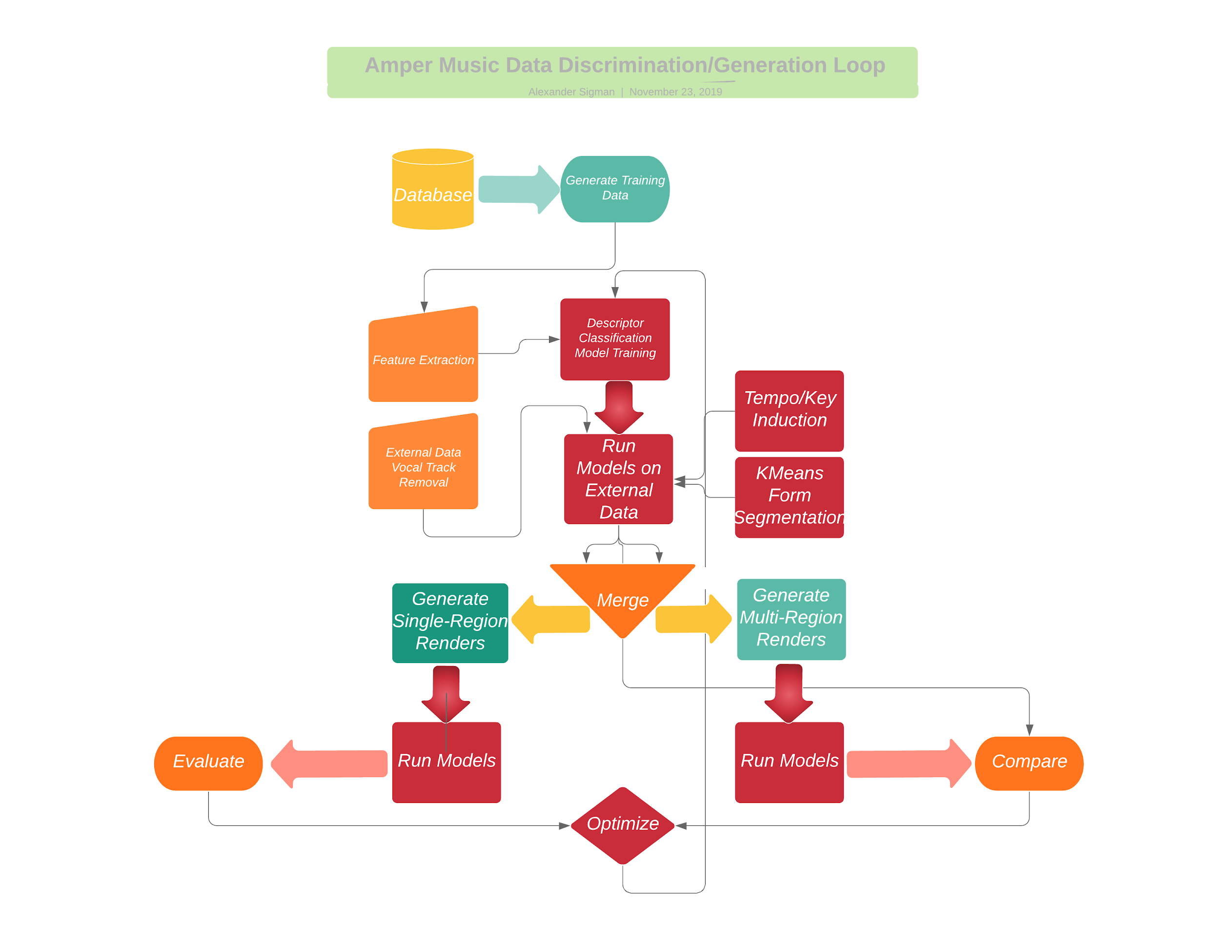
Project Methodology

Slide 15
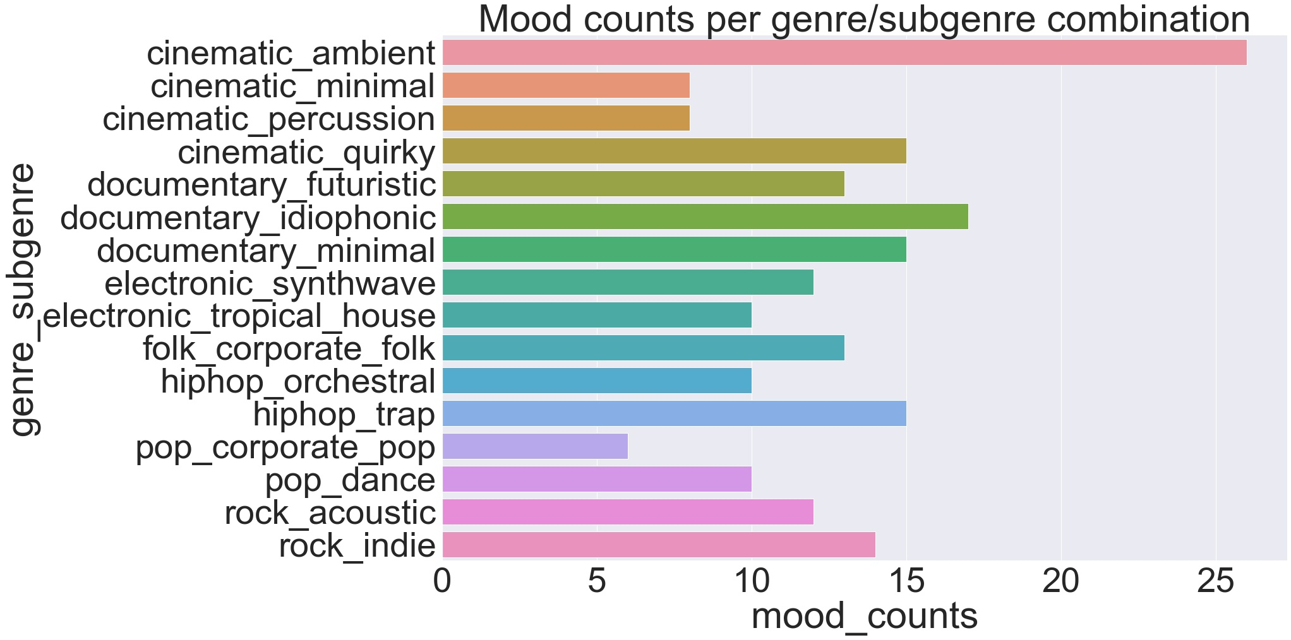

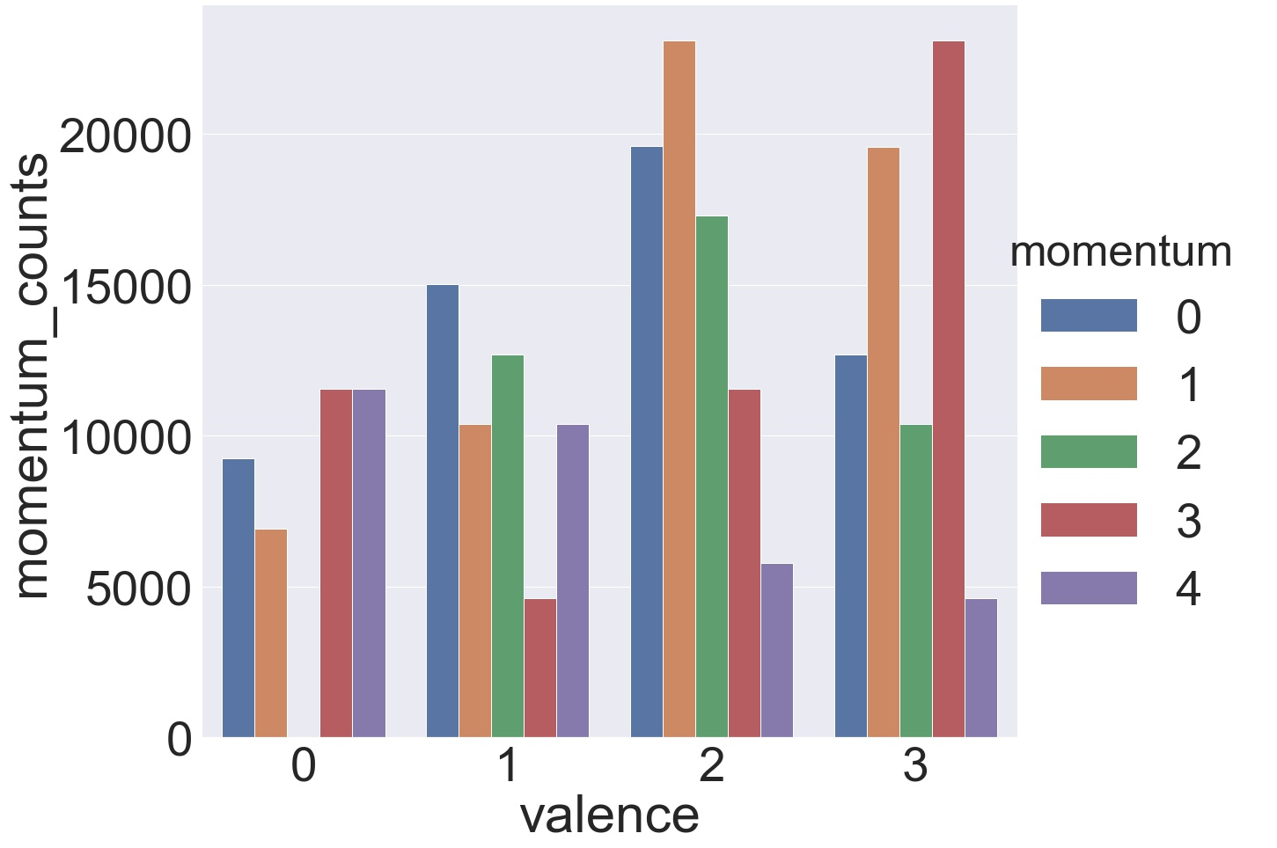
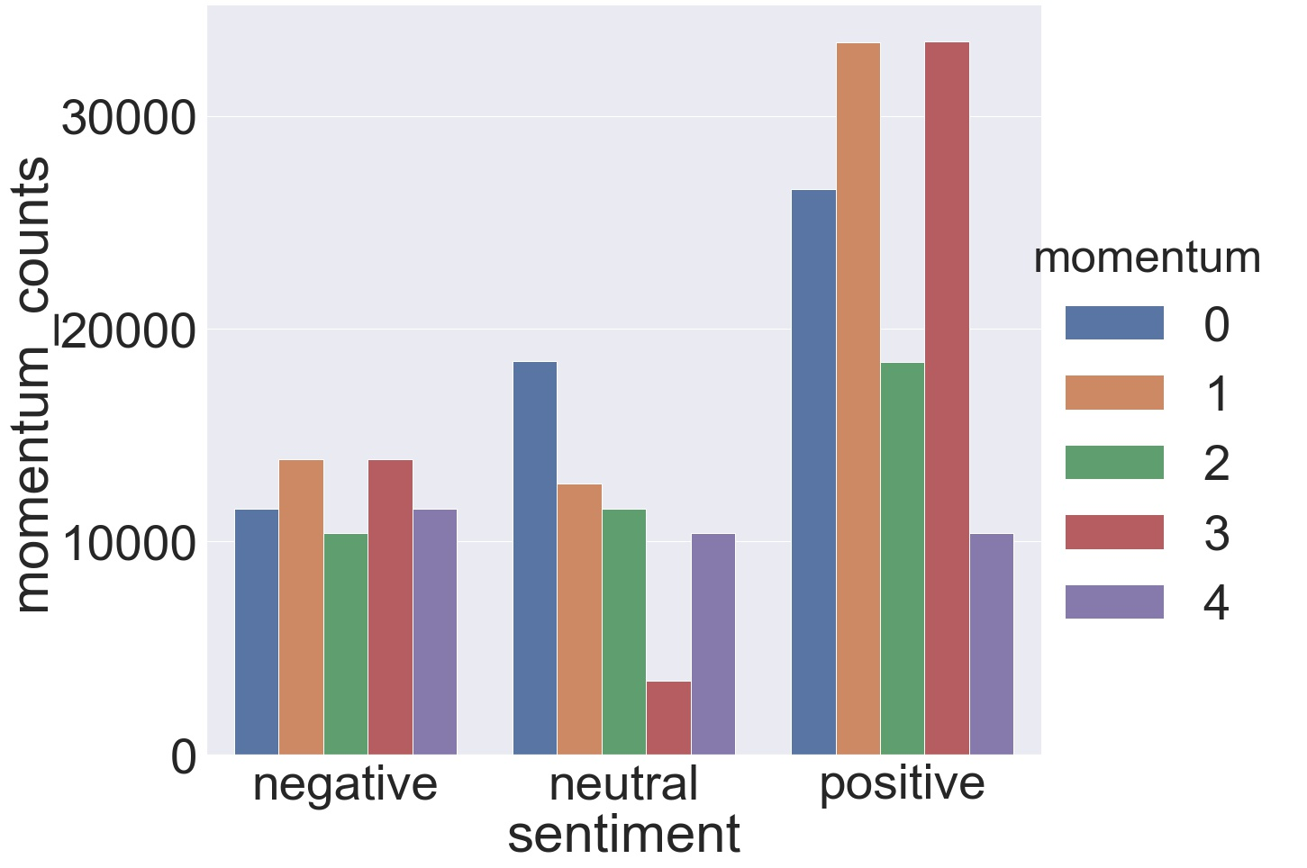
EDA: Amper Training Data
204 descriptors
99 examples of each
33 at each of 3 durations: 10, 30, and 60 seconds
Random instrumentation and tempo for each example

Slide 16
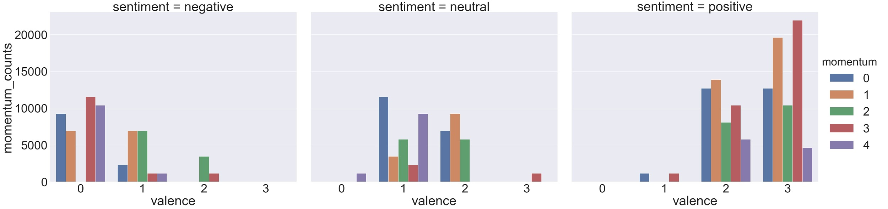
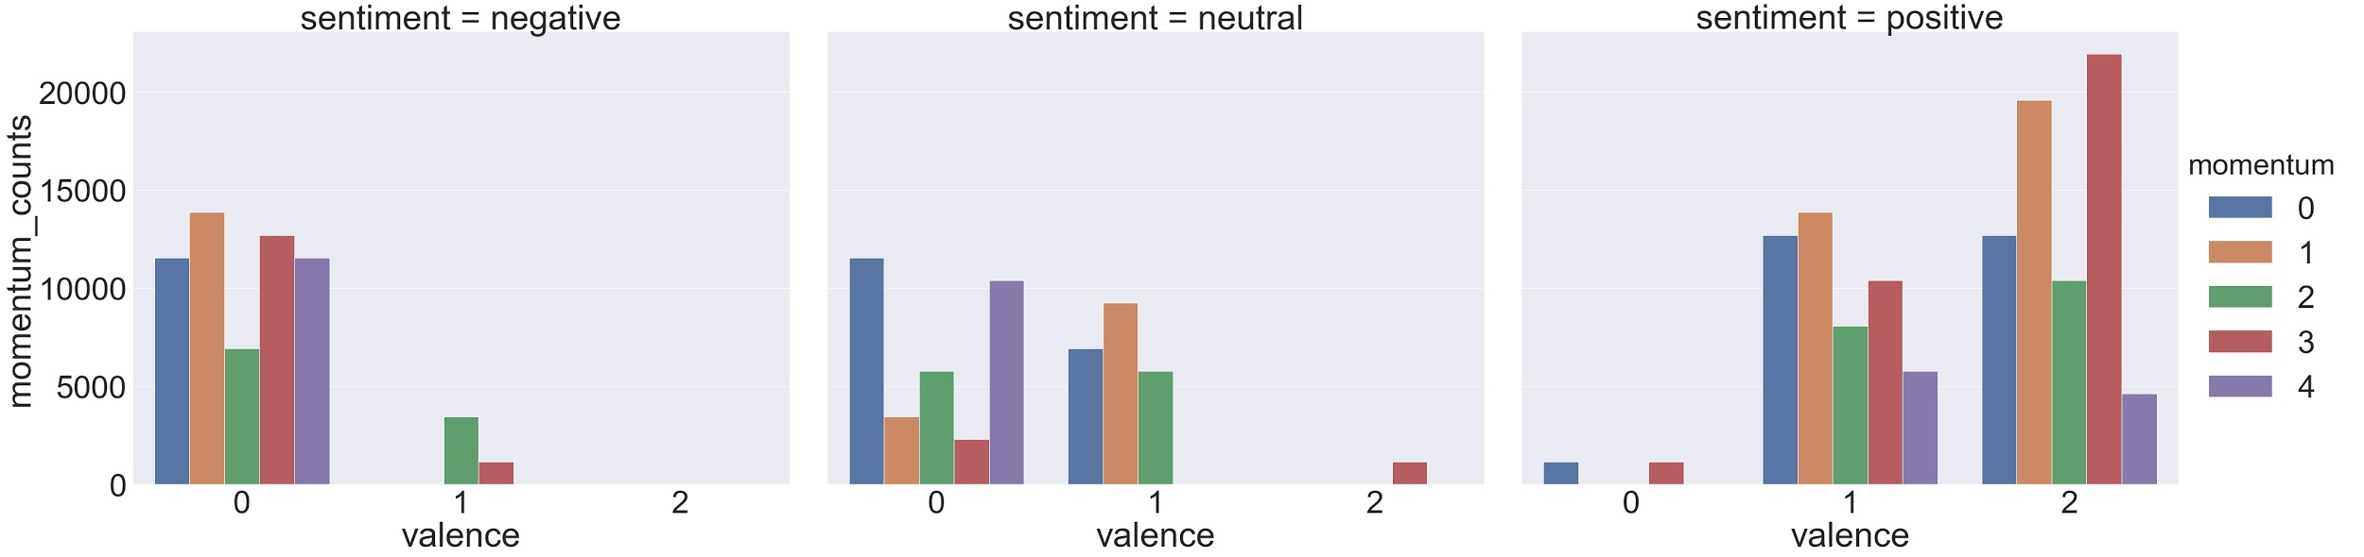
EDA: Amper Training Data
Pre-collapse:
3 sentiments:
Negative: 49 descriptors
Neutral: 51 descriptors
Positive: 104 descriptors
Post-collapse:

Slide 17
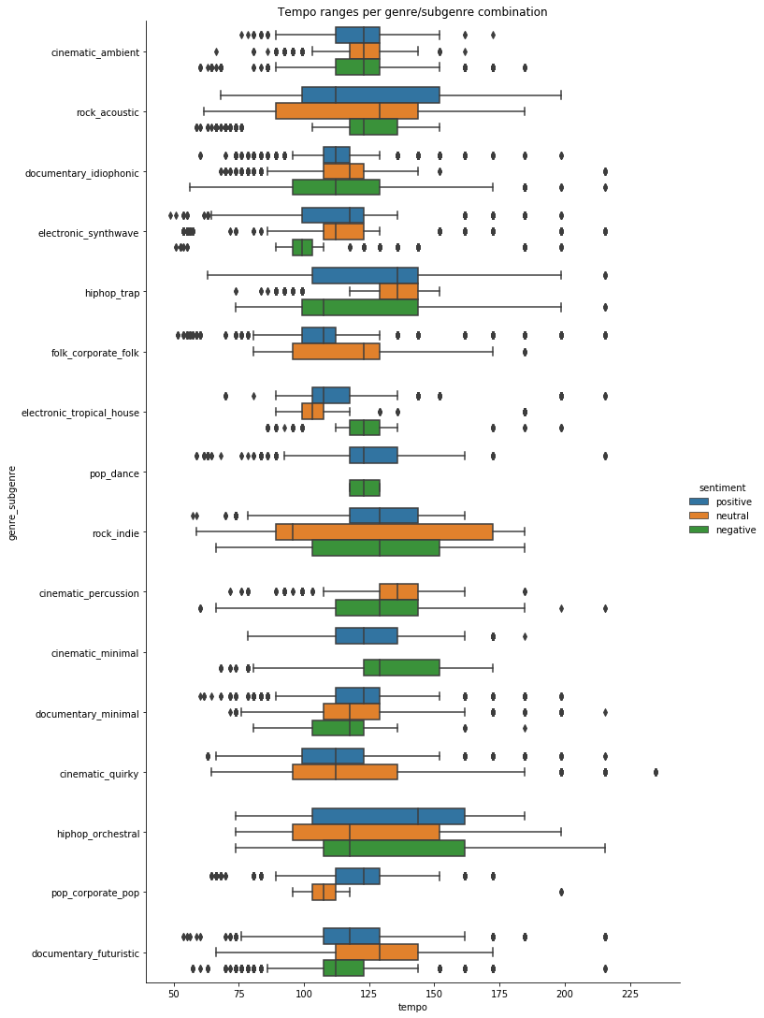
Feature Extraction
21 salient features:
3 Mel Frequency Cepstral Coefficients (MFCC)
3 PCA coefficients
15 spectral and temporal parameters (including tempo)

Slide 18
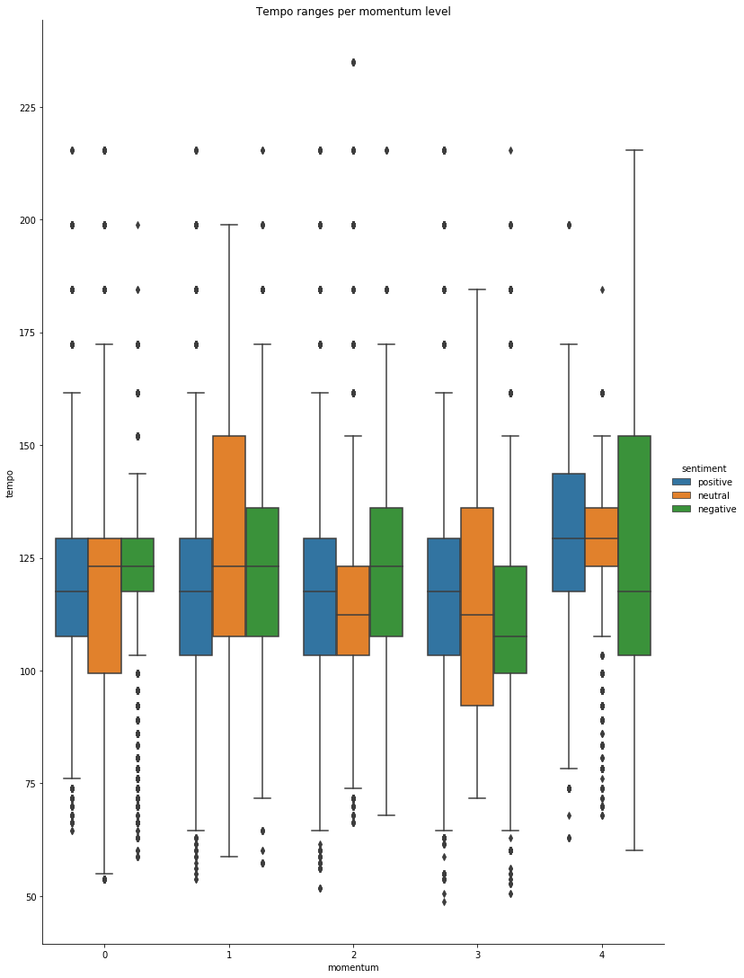
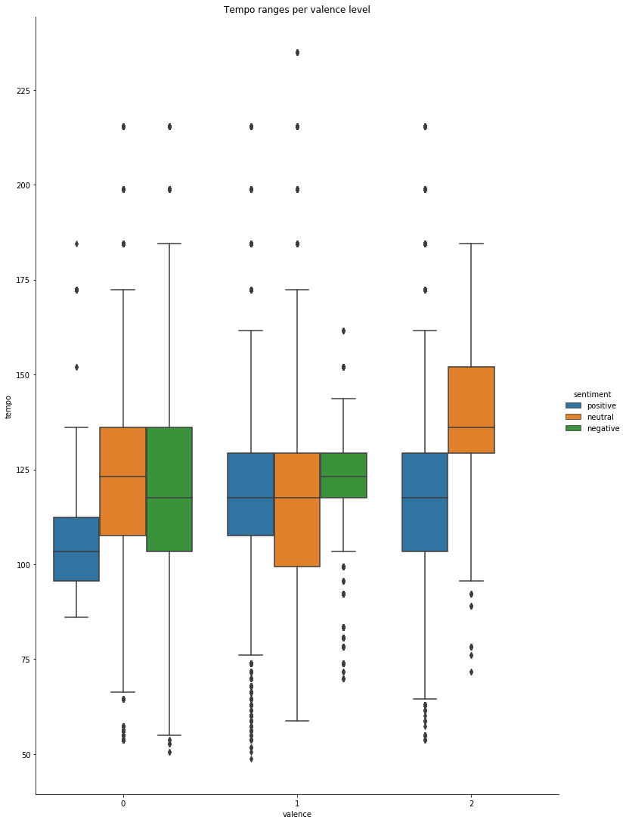
Feature Extraction
Hand-engineered ordinal categorical features:
Valence (4 point -> 3 point scale)
Momentum (5 point scale)
Every mood assigned 1 valence and 1 momentum level

Slide 19
Feature Extraction: Soundfile Segmentation
Window size: 10 seconds
Stride: 2 seconds
# of examples: 240,000

Slide 20
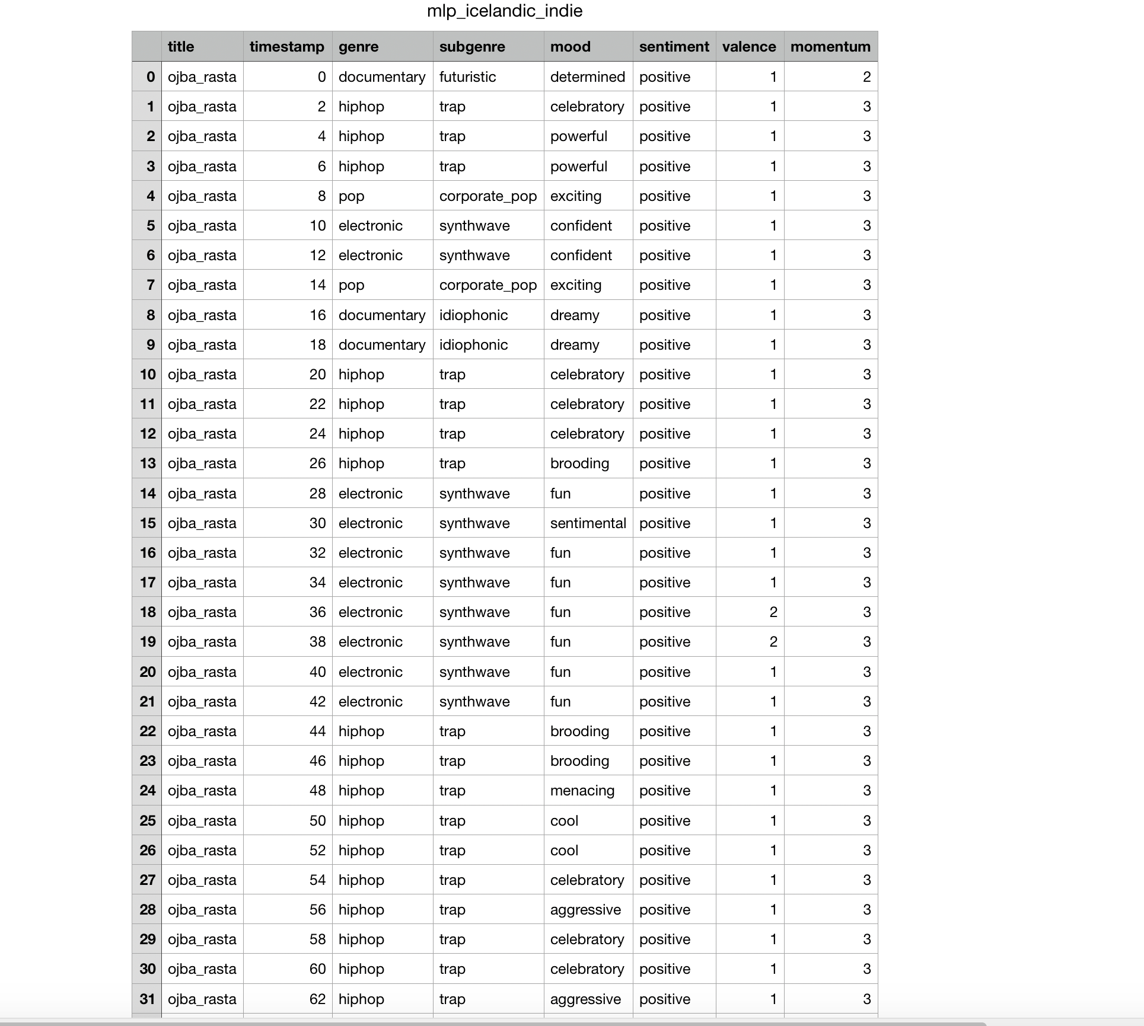
Models: Target Descriptor Variables
Genre (Binary)
Subgenre
Mood
Sentiment (Binary)
Valence
Momentum

Slide 21
Models: KNN vs. MLP Performance
Target | KNN | MLP
Binary Genre | 0.999 | 0.990
Binary Sentiment | 0.992 | 0.924
Subgenre | 0.530 | 0.535
Mood | 0.983 | 0.972
Valence | 0.995 | 0.973
Momentum | 0.995 | 0.943

Slide 22
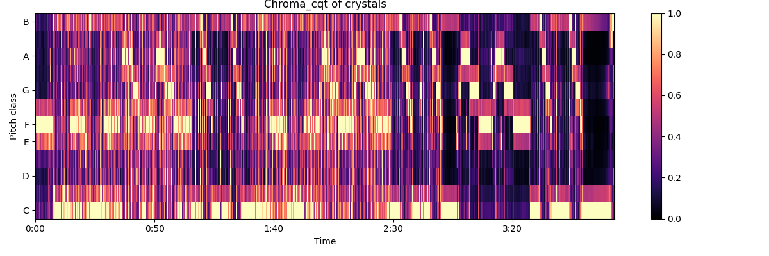
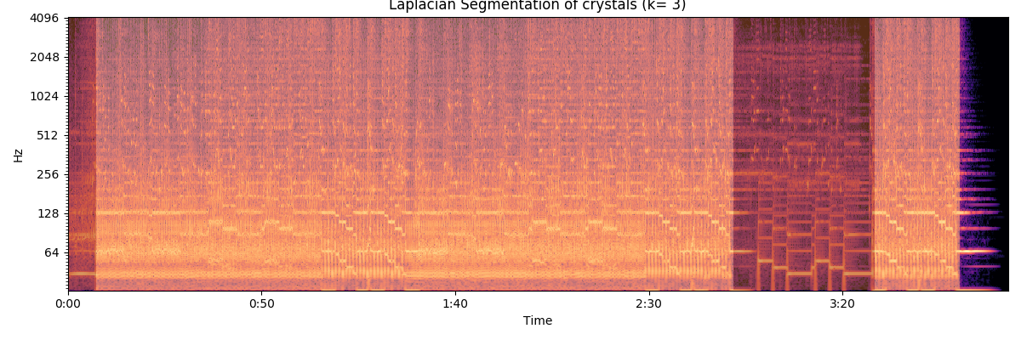
Models: Tempo/Key Detection and Laplacian Form Segmentation
Key: LibROSA library CQT (constant-Q transform) utility
Form: KMeans clustering driven Laplacian audio segmentation algorithm, with silhouette analysis (max average)

Slide 23
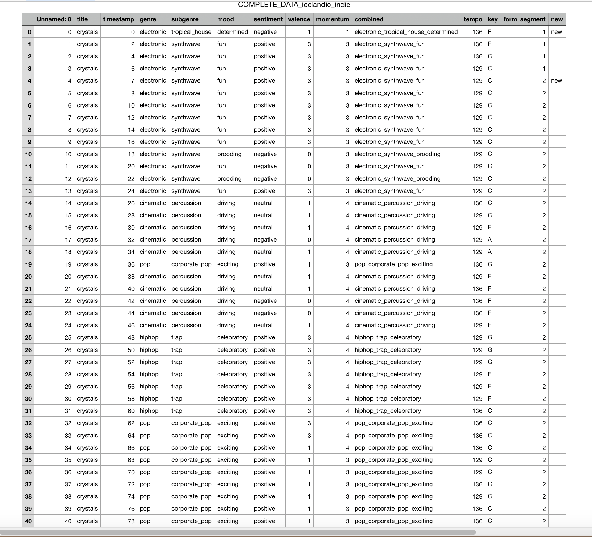
Models: Integrated Output

Slide 24
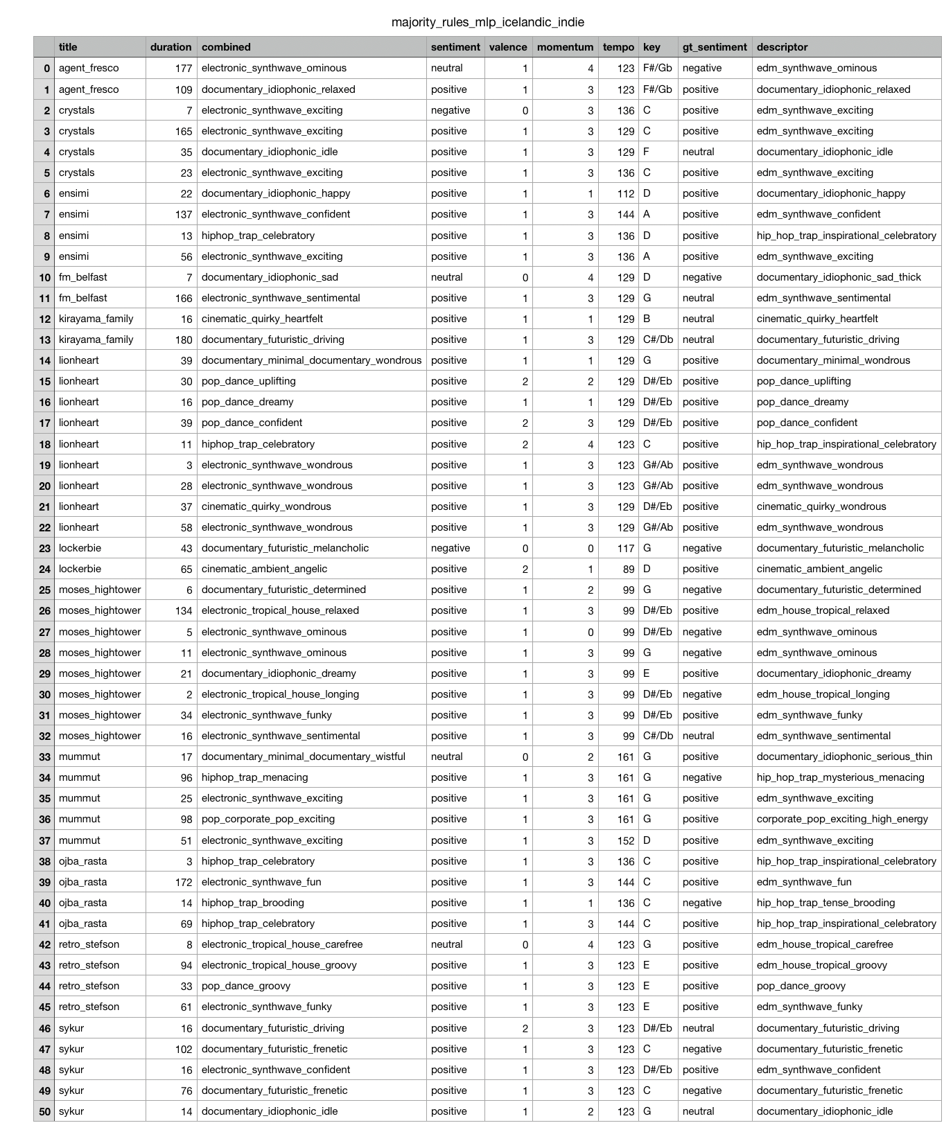
Models: Output Redux
Top predicted descriptor + sentiment + tempo + key per formal segment per track

Slide 25
Render Generation
Multi-region (10 per input track): each region assigned respective duration, descriptor, tempo, and key

Slide 26
Render Generation
"timeline": {
"spans": [
{
"actions": [
{
"time": 0,
"add_region": {
"key": {
"tonic": "C"
},
"id": 222,
"cut_at": 48,
"descriptor": "documentary_idiophonic_idle"
}
}],
"time": 0,
"tempo": 136.0,
"id": 111,
"type": "metered",
"instrument_groups": [{"instrument_group": "grand_piano"}]
},
{
"time": 344,
"type": "unmetered"
}
]
}
Multi-region (10 per input track): each region assigned respective duration, descriptor, tempo, and key
Single-region: each render assigned one of top descriptors, tempi, and keys

Slide 27
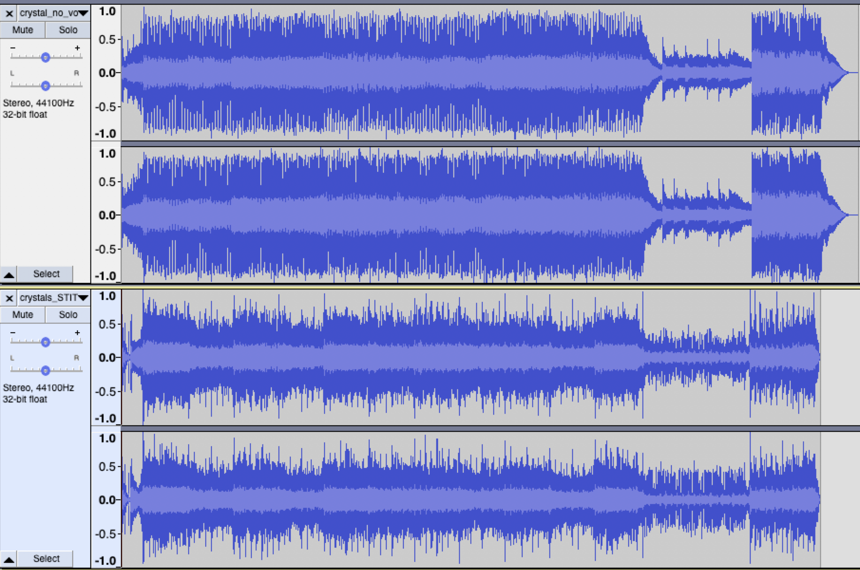
Render Example

Slide 28
Validation: Single Region Render Accuracy Scores
Classifier | Accuracy Score
Genre | 0.897
Subgenre | 0.858
Mood | 0.715
Sentiment | 0.821
Valence | 0.705
Momentum | 0.752

Slide 29
Validation: Multi Region Render Mean Correlation Scores
Classifier | Mean Correlation Score
Genre | 0.900
Subgenre | 0.855
Mood | 0.755
Sentiment | 0.635
Valence | 0.686
Momentum | 0.413

Slide 30
Multi Region Individual Scores by Track
Genre accuracy scores by title:
[('agent_fresco', 1.0), ('crystals', 1.0), ('ensimi', 0.75), ('fm_belfast', 0.5), ('kirayama_family', 1.0), ('lionheart', 1.0), ('lockerbie', 1.0), ('mummut', 1.0), ('ojba_rasta', 0.75), ('retro_stefson', 1.0 )]
Subgenre accuracy scores by title:
[('agent_fresco', 1.0), ('crystals', 1.0), ('ensimi', 0.75), ('fm_belfast', 0.5), ('kirayama_family', 1.0), ('lionheart', 1.0), ('lockerbie', 1.0), ('mummut', 0.8), ('ojba_rasta', 0.75), ('retro_stefson', 0.75)]
Mood accuracy scores by title:
[('agent_fresco', 1.0), ('crystals', 1.0), ('ensimi', 0.5), ('fm_belfast', 0.5), ('kirayama_family', 1.0), ('lionheart', 1.0), ('lockerbie', 1.0), ('mummut', 0.8), ('ojba_rasta', 0.25), ('retro_stefson', 0.5)]

Slide 31
Multi Region Individual Scores by Track
Sentiment accuracy scores by title:
[('agent_fresco', 0.5), ('crystals', 0.5), ('ensimi', 1.0), ('fm_belfast', 0.0), ('kirayama_family', 0.0), ('lionheart', 1.0), ('lockerbie', 1.0), ('mummut', 0.6), ('ojba_rasta', 1.0), ('retro_stefson', 0.75)]
Valence accuracy scores by title:
[('agent_fresco', 0.0), ('crystals', 1.0), ('ensimi', 0.75), ('fm_belfast', 0.5), ('kirayama_family', 1.0), ('lionheart', 0.5555555555555556), ('lockerbie', 1.0), ('mummut', 0.8), ('ojba_rasta', 0.25), ('retro_stefson', 0.5)]
Momentum accuracy scores by title:
[('agent_fresco', 0.0), ('crystals', 0.5), ('ensimi', 0.5), ('fm_belfast', 0.0), ('kirayama_family', 0.0), ('lionheart', 0.7777777777777778), ('lockerbie', 0.5), ('mummut', 0.6), ('ojba_rasta', 0.75), ('retro_stefson', 0.5)]

Slide 32
Conclusions

Slide 33
Initial Phase Achievements
Trained classification models on Amper data, applied to music data *from the wild”
Integrated (supervised) descriptor classification, tempo/key induction, and (unsupervised) form segmentation models
Generated renders based upon classifier predictions
Classifiers produce generally accurate predictions on single-region renders for genre/subgenre/sentiment
Similar results for multi-region render correlation with reference track classification

Slide 34
Initial Phase Findings
Sentiment class imbalance
Discrepancy between classification model performance on test set of train data and on renders (taking accuracy, precision, and F1 scores into account)
Low accuracy scores for renders on mood, valence, and momentum
High variance on model accuracy across input (reference) tracks

Slide 35
(Current and) Future Work

Slide 36
More Data!
Training set => a larger number of renders across a larger number of descriptors (new descriptors introduced on a consistent basis)
Apply models to Free Music Archive (FMA) dataset

Slide 37
Descriptor Space Distance Metric
Distances amongst genres, subgenres, and moods not equal
Gradient of instrumentation, mean tempo, harmonic rhythm, harmonic progression, etc.
Penalty weights: reflective of descriptor space, learned by model
Input off the map: <UNK> class

Slide 38
Audio-to-Timeline Proof of Concept Protype (nearly complete)
End-to-end app: user inputs audio, app classifies audio and outputs timeline (for render generation purposes)
For internal purposes: collect feedback from Asset Creation team and other key players
Deployed as Flask app

Slide 39
Thanks!
Questions?

Slide 40
Links
Amper Music: www.ampermusic.com
LibROSA: https://librosa.github.io/librosa/
Free Music Archive (FMA) Dataset: https://github.com/mdeff/fma
LinkedIn: https://www.linkedin.com/in/alexander-sigman-6718b414/
Paper: https://docs.google.com/document/d/15gRSPSkZk0vBcfmBzoCgirPLicGmKINwtFdKQQHvdQM/edit?usp=sharing

